Slide 1

What workloads are each of the ZFS configurations most appropriate for?
Matthew Swain
Supervised by: Mark Greenwood
School of Mathematics, Computer Science and Engine

Slide 2
Table of contents
1
2
3
Introduction
ZFS Basics
Methodology
4
5
Results and Analysis
Conclusion

Slide 3
Introduction

Slide 4

Introduction
When data needs to be reliably stored for long periods of time, using a single disk will not be enough. Disks, especially hard drives, are susceptible to failure over time, and once they do fail, the data they contain can be irretrievably lost.
File systems can incorporate a RAID system, which allows multiple drives to be grouped together into a singular array. This then allows users to create a configuration where, if one drive fails, not all data is lost. It does this by splitting any files to be written into blocks, the smallest atomic unit of data storage. These blocks can then be distributed amongst the disks in numerous ways, such as writing the same block to multiple disks.
However, RAID implementations in conventional file systems can suffer from a number of issues, such as difficulty of management, lack of data integrity and poor performance. Additionally, if the user creates an array with a RAID controller, if this fails, it can bring down the entire array and all its data with it.
Notes:
Explain RAID1 and RAIDZ0
They can be difficult to manage, for instance if a user wanted to expand an array, they may have to take the existing array offline, partition
Bit rot, data can be susceptible to becoming corrupt

Slide 5

Introduction
ZFS aims to solve these issues by changing how a file system interacts with the disks. Rather than having a direct relationship between a physical disk and a logical disk that forms part of an array, ZFS instead treats all disks as contributing towards a pool of blocks. Sections of the pool that can then be allocated as needed, allowing much easier growing and shrinking.
ZFS also interacts with the disks directly rather than through a RAID controller. When using a controller, traditional file systems trust that any data received from the controller is the same as data that has been given to it. This is not always the case however, potentially leading to irreversibly corrupt data. ZFS instead interacts directly with the disks, eliminating any unreliable third party, as well as incorporating checksums into the data. These allow the file system to regularly perform calculations on the data to make sure that none of the data has corrupted.
Despite these extra systems in place, ZFS is still extremely performant and, if the correct configuration for the situation is used, it can greatly outperform other RAID arrays. However, if a user creates an array that is not well suited to their workload, it can lead to extremely poor performance.
Notes:
ZFS distributes the blocks out to each dataset depending on how much they have been allocated, this allows easier growing and shrinking

Slide 6
ZFS Basics

Slide 7
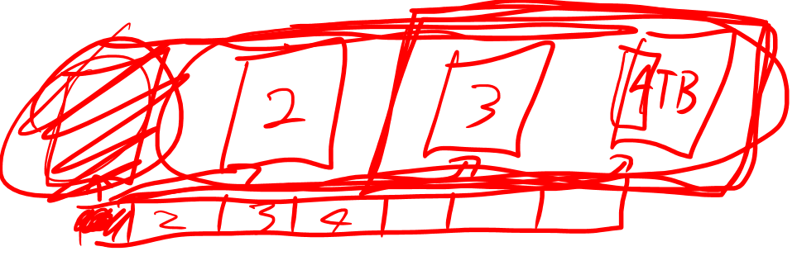
ZFS Basics
Stripe: Each block is written to one disk. As a result, read and write speeds are extremely fast as each disk can handle its own block. However, as the blocks one disk stores are not held anywhere else, if a single disk in the array fails, all blocks forming a file can no longer be retrieved and all data will be lost. Mirror: Each block is written to every single disk, ensuring that no one disk failure will result in the failure of the whole array. As a result, the amount of available storage is limited to that of a single disk. Additionally, write speeds are limited to that of a single drive as ZFS must wait for every single drive in the array to finish writing the block before it is considered completed. Read speeds are not affected however, as each disk can retrieve different blocks.
Notes:
As using the correct ZFS config for the workload is important

Slide 8
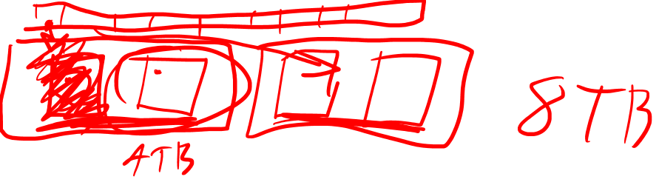
ZFS Basics
Vdevs and striped mirrors: To improve the flexibility of ZFS, a virtual device or vdev can be created. This allows multiple devices to be treated as one virtual device that can then be used in a pool. For example, if a user had 6 disks, they may create 3 vdevs, with each vdev containing 2 disks in a mirror configuration. These 3 vdevs could then be put into a stripe configuration, resulting in some of the performance of a stripe, with some of the data redundancy of a mirror. Blocks can be striped across the 3 vdevs, but each block written is mirrored on both disks in the vdev. As a result, one disk in a vdev can fail without the pool failing, with up to 3 disks total being able to fail. These 3 disks must each be from different vdevs however, as, if 2 disks in a vdev were to fail, all blocks stored in said vdev would be irretrievably lost and the array would fail. This configuration also does not offer the highest amount of storage space as it can never be more than 50% of the total capacity.
Notes:
Could modify to 3 mirrored disks in a vdev but then only two disks of space are available.

Slide 9
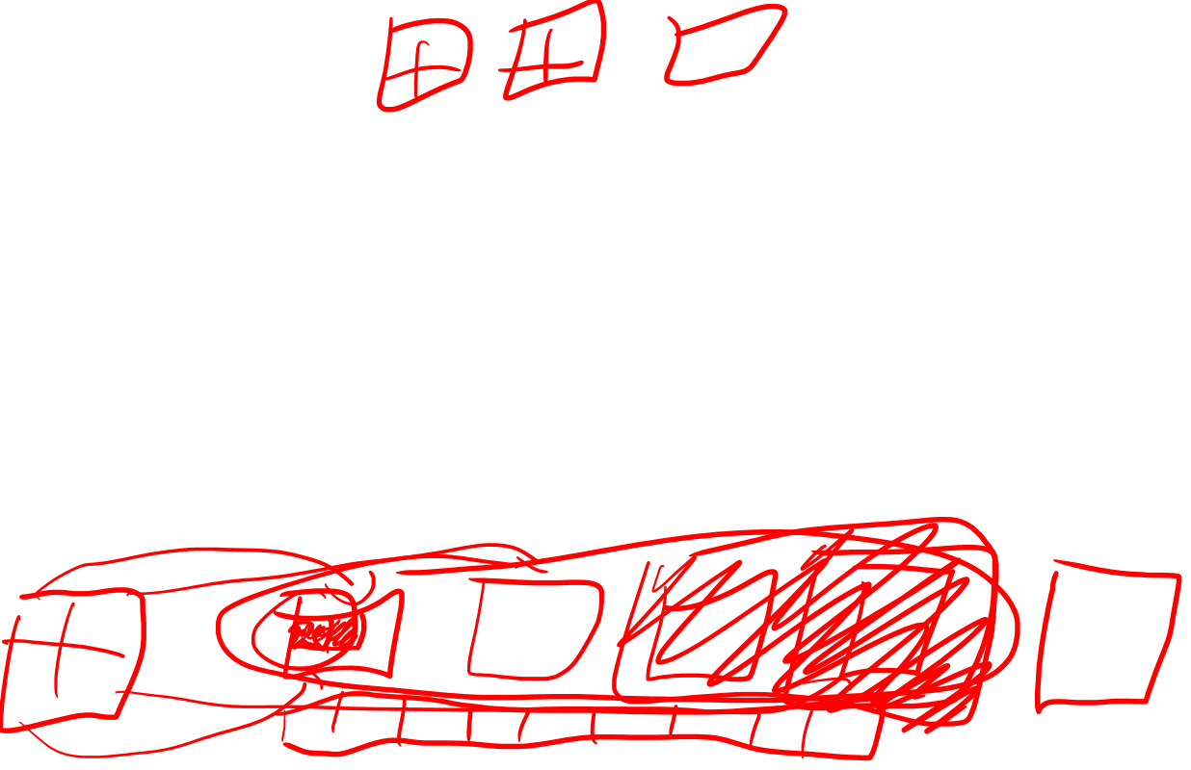
ZFS Basics
RAIDZ: To achieve a potentially better balance, RAIDZ configurations take a somewhat more complex approach. When the pool or vdev is being created, a certain number of disks worth of storage are designated as parity disks. The number of parity disks is designated by the name, for instance a RAIDZ1 uses 1 disks worth of storage for parity data, RAIDZ2 uses 2 and RAIDZ3 uses 3. Then, when data is being written, blocks are distributed among vdevs, but once a block is handed to a vdev, it is then further subdivided into sectors. In a stripe, these sectors are written sequentially, and, in a mirror, all sectors are written to all disks. In a RAIDZ vdev, these sectors are striped across all disks with 1, 2 or 3 extra parity sectors written as well. When a disk is lost, these parity sectors can be used in conjunction with the remaining data sectors in a calculation to rebuild the lost sectors. This does come at a cost of performance, with random read and writes speeds usually being equivalent to that of a single drive. Sequential read/writes on the other hand, are usually equal to the speed of a single drive multiplied by the number of data disks.

Slide 10
Methodology

Slide 11
Methodology
To test what workload each of these configurations are most suited to, a test platform is needed.
Dell R520
2 Intel Xeon E5-2407 CPUs
88GB of DDR3 1066MHZ RAM
Perc H310 RAID controller
Proxmox installed on two WD SSDs in a mirror configuration
6 4TB Seagate Ironwolf hard drives
A virtual machine running Ubuntu server 22.04
VM has been dedicated 4 CPU cores
VM has between 2GB and 4GB of RAM depending on the test
All tests have been performed with ARC set to 128MiB
ZFS default block size of 128KiB used

Slide 12
Methodology
Filebench: This piece of software has been used for its included macro benchmarks that simulate the operations performed by certain workloads. For this experiment, 3 workloads have been selected, the first of which is the fileserver. This contains a variety of operations such as writing a new 1MB file, appending 16kB, reading and deleting a file. With 35,000 files and 50 simultaneous instances of these operations, it simulate a busy fileserver. The second scenario, the videoserver contains two datasets. One active dataset receiving 48 continuous 256kB reads on 2GB files and a passive dataset containing 1 instance of 2GB files receiving deletions, creations and writes every 10 seconds. The final scenario, the MongoDB workload contains 300,000 16kB files receiving a mix 16kB read and write operations. All of these workloads should give a wide range of use cases and operation types.
Flexible I/O Tester: For more granular data, fio has been used, allowing for deeper insight into the performance for random and sequential pure read, pure write and mixed read/write operations. Three different workloads have also been used to see how these operations are affected by the workload type. The first is a general use scenario, where 16 sets of 64KiB operations are being performed on 256MiB files. The second is a best case scenario where 1MiB operations are being performed on a 16GiB file. The final scenario is a 4GiB file receiving small 4KiB operations.

Slide 13
Results and Analysis

Slide 14
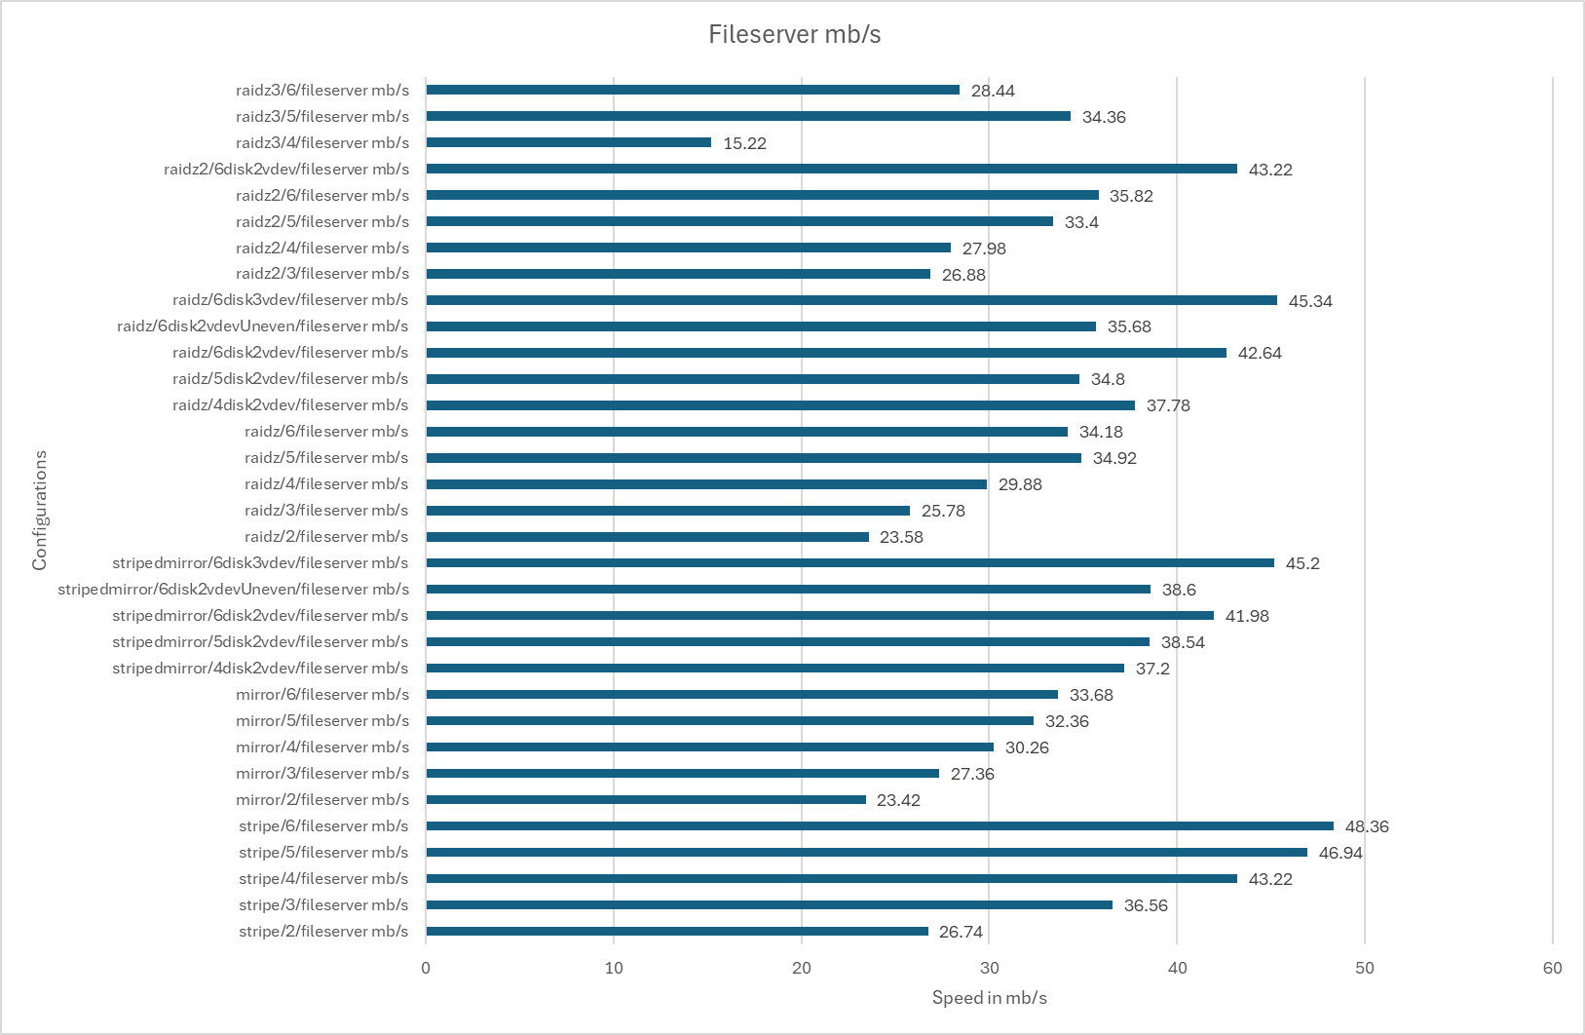
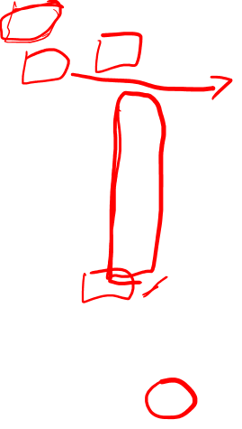
Results and analysis
Filebench:
Fileserver

Slide 15
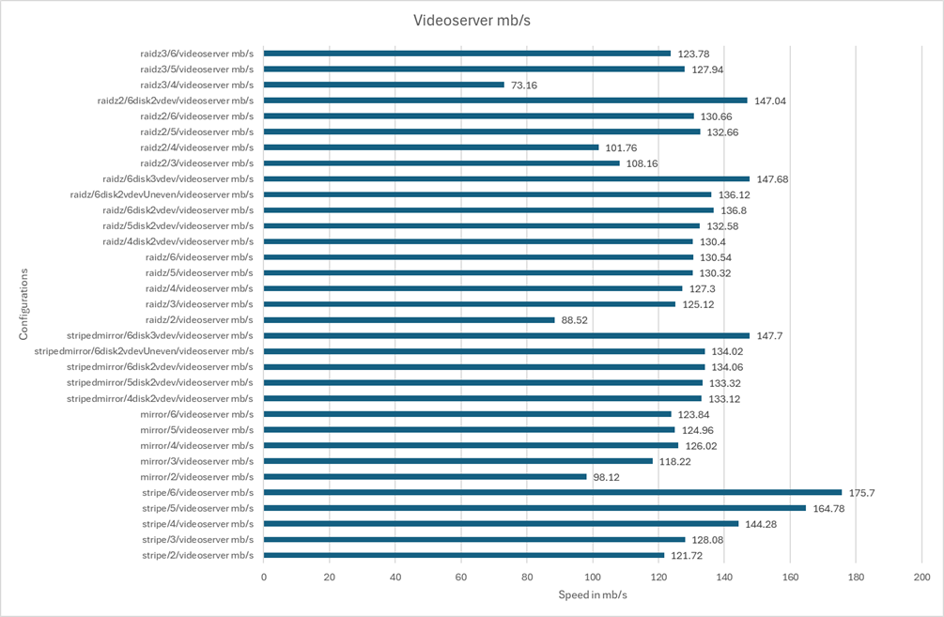
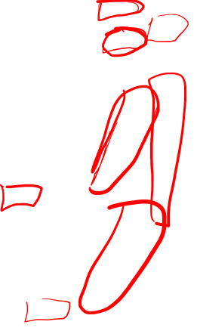
Results and analysis
Filebench:
Videoserver

Slide 16
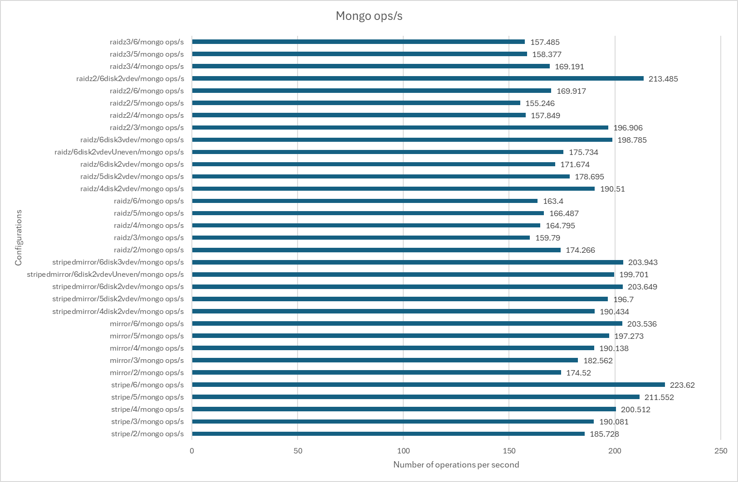

Results and analysis
Filebench:
MongoDB
Server

Slide 17
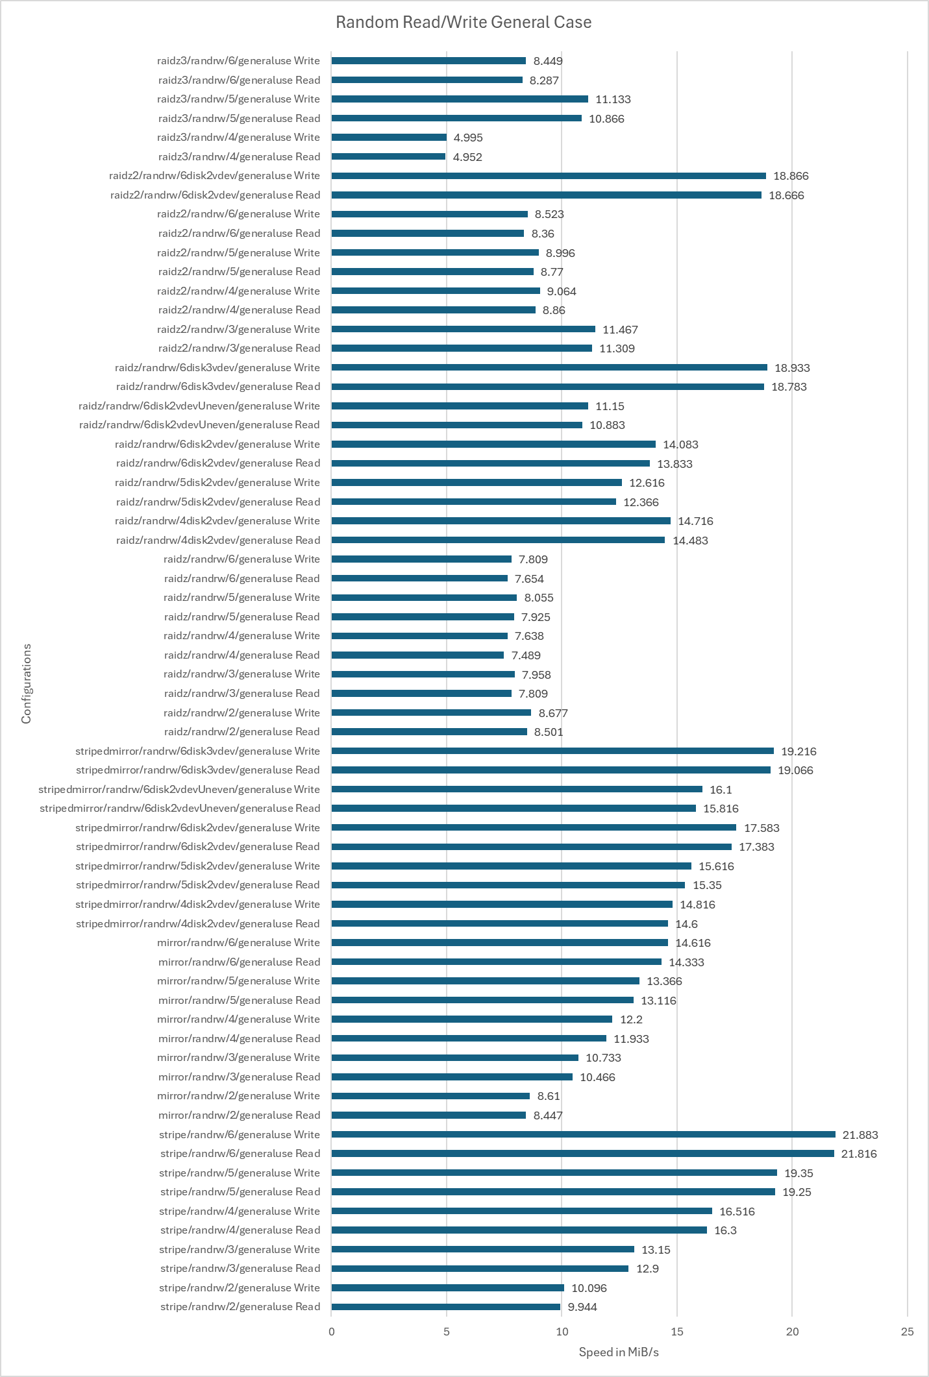
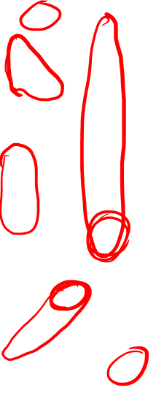
Results and analysis
Fio,
Random Read/Write, General Use

Slide 18
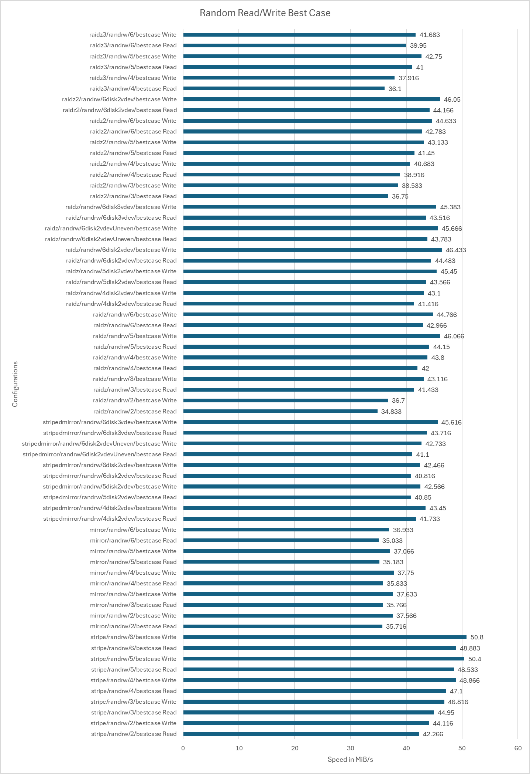

Results and analysis
Fio,
Random Read/Write, Best Case

Slide 19
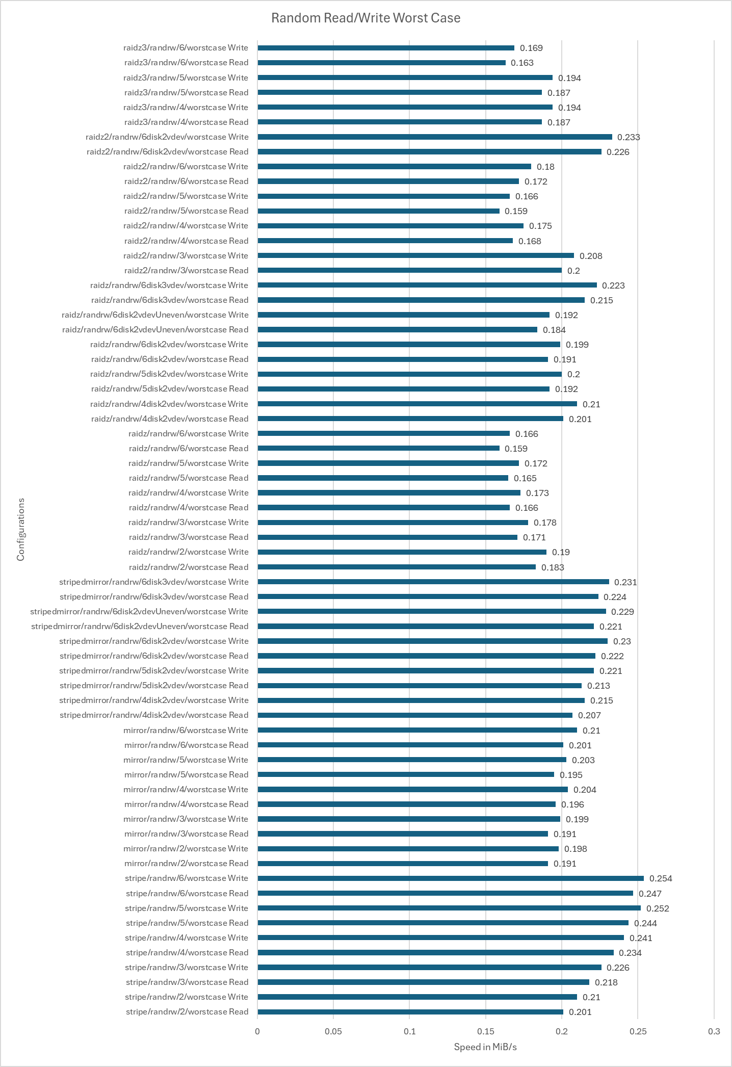

Results and analysis
Fio,
Random Read/Write, Worst Case

Slide 20
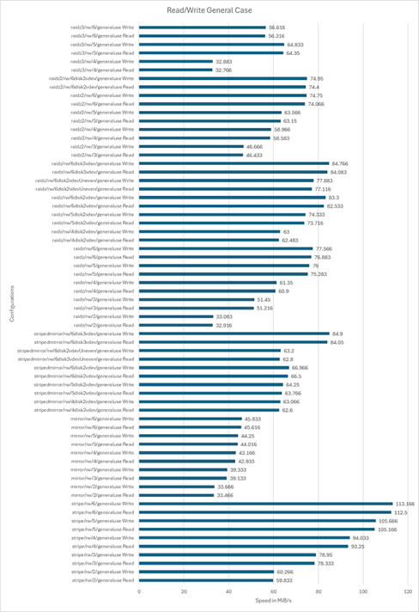

Results and analysis
Fio,
Sequential Read/Write, General Use

Slide 21
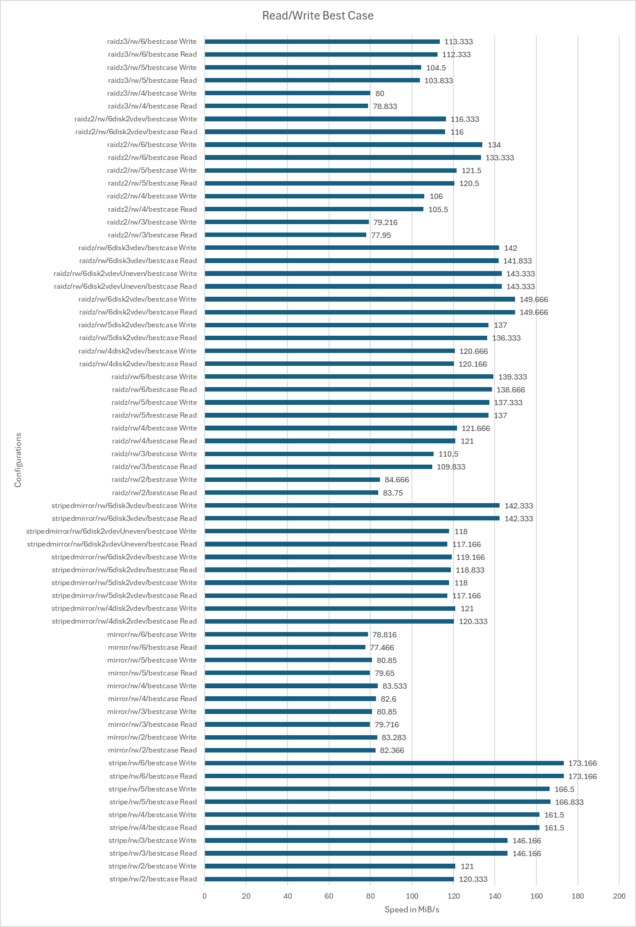

Results and analysis
Fio,
Sequential Read/Write, Best Case

Slide 22
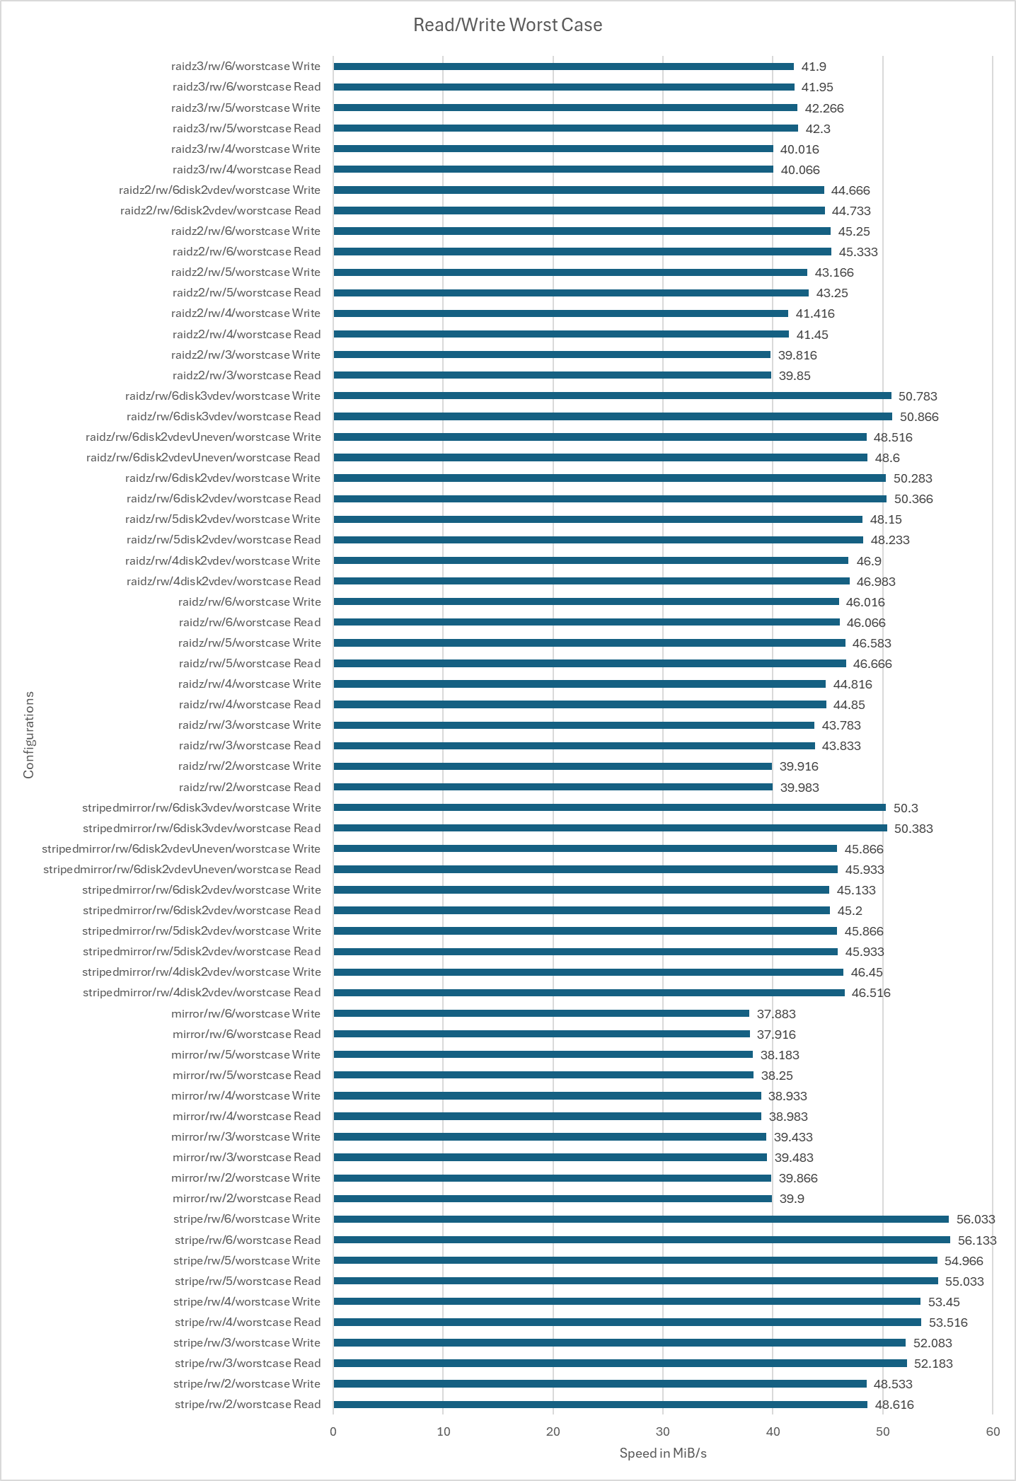

Results and analysis
Fio,
Sequential Read/Write, Best Case

Slide 23
Conclusion

Slide 24
Conclusion
While not perfect for every scenario, a single vdev RAIDZ2 provides a good balance of storage space and reliability. Performance is often good, if not outstanding, although random performance is not always ideal. Could be improved with Adaptive Replacement Cache and a Separate Intent Log.
If IOPS were critical, a pool with 3 mirror or RAIDZ1 vdevs is also a good option, often giving the best performance in all scenarios. This does however come with a smaller amount of storage space and each vdev only being able to sustain one drive loss before array failure.
When decreasing the number of disks, RAIDZ2 remains a good option at 4-5 disks, although offering a poorer storage to capacity ratio. RAIDZ1 can become a more compelling configuration offering less redundancy but better storage capacity. Multi or single vdev mirrors also remain good options depending on the users need for storage space, speed or capacity.
Some configurations such as the 2 vdev RAIDZ2 or 5 disk RAIDZ3 arrays offer surprisingly good performance, so more research would need to be conducted to see if this anomalous behaviour continues. Often not a good choice due to poor storage space availability so further research could also be conducted to see how these arrays compare with higher disk numbers.
Stripe configurations are rarely a good choice unless the user requires speed above all else and has
other copies of the data.

Slide 25
Conclusion
For more in-depth analysis, the full paper, recorded figures and scripts used can be found in the following GitHub repo:
https://github.com/MatthewSwain21101660/ZFSDissertation
Thank you for listening

